Slide 1
FAO
Name of the group: TOEDRO
Members: Rocco Felici
Edoardo Silva
Tommaso Vitali
USI Lugano, December 1, 2020

Slide 2
Goal of the APP
Fao allows the user to evaluate the calories burnt based on the conversion of the number of steps done during the day and basal metabolic rate in kilocalories and lets the user store the ingredients that have at home on a digital pantry. The app, thanks to these data, recommends a recipe that uses the ingredients available in the pantry and ensures the correct amount of calorie intake that the user needs. The aim is to grant a correct personalized diet that can prevent bad habits such as bad nutrition, eating too much or less than necessary, and even prevent food disorders.
Fao provides a series of functionalities: a background functioning step-counter to keep count of the steps even while using other apps, grants an automatic conversion of the number of steps in kilocalories, permits the user to upload the ingredients manually or by scanning the barcode on the product, visualizes the number of calories burnt and steps done during the days, implements two databases, the first local one that stores the information about the user and serves as a pantry of the available ingredients and a second remote one that stores the recipes.

Slide 3
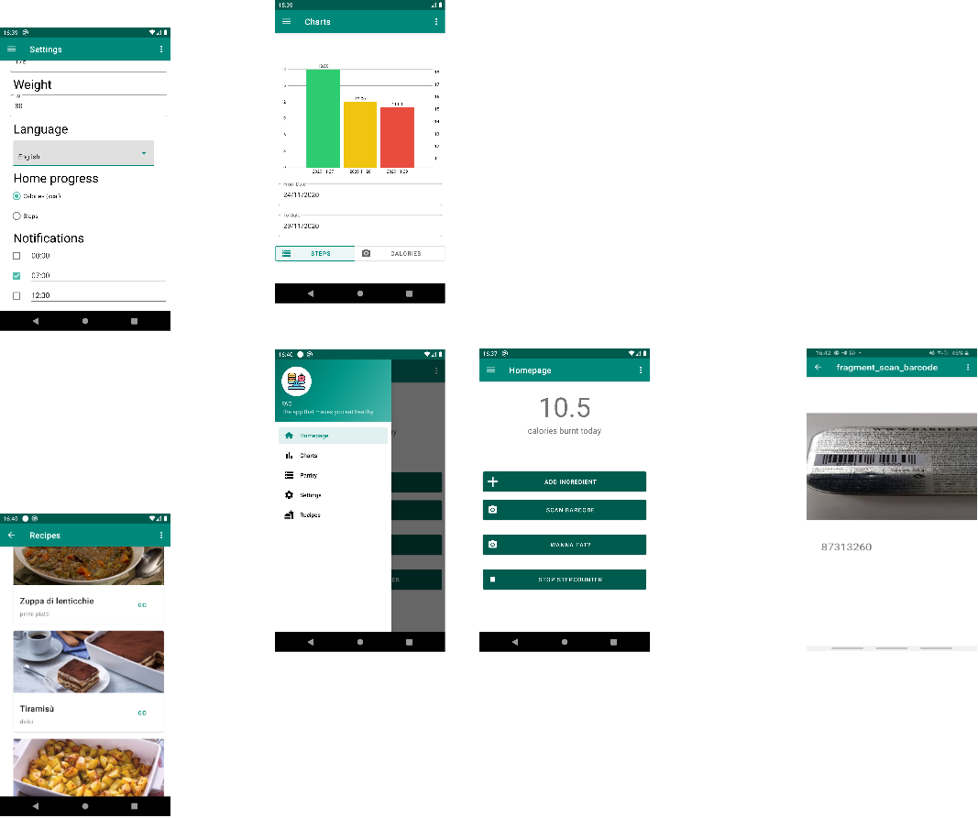
APP storyboard

Slide 4
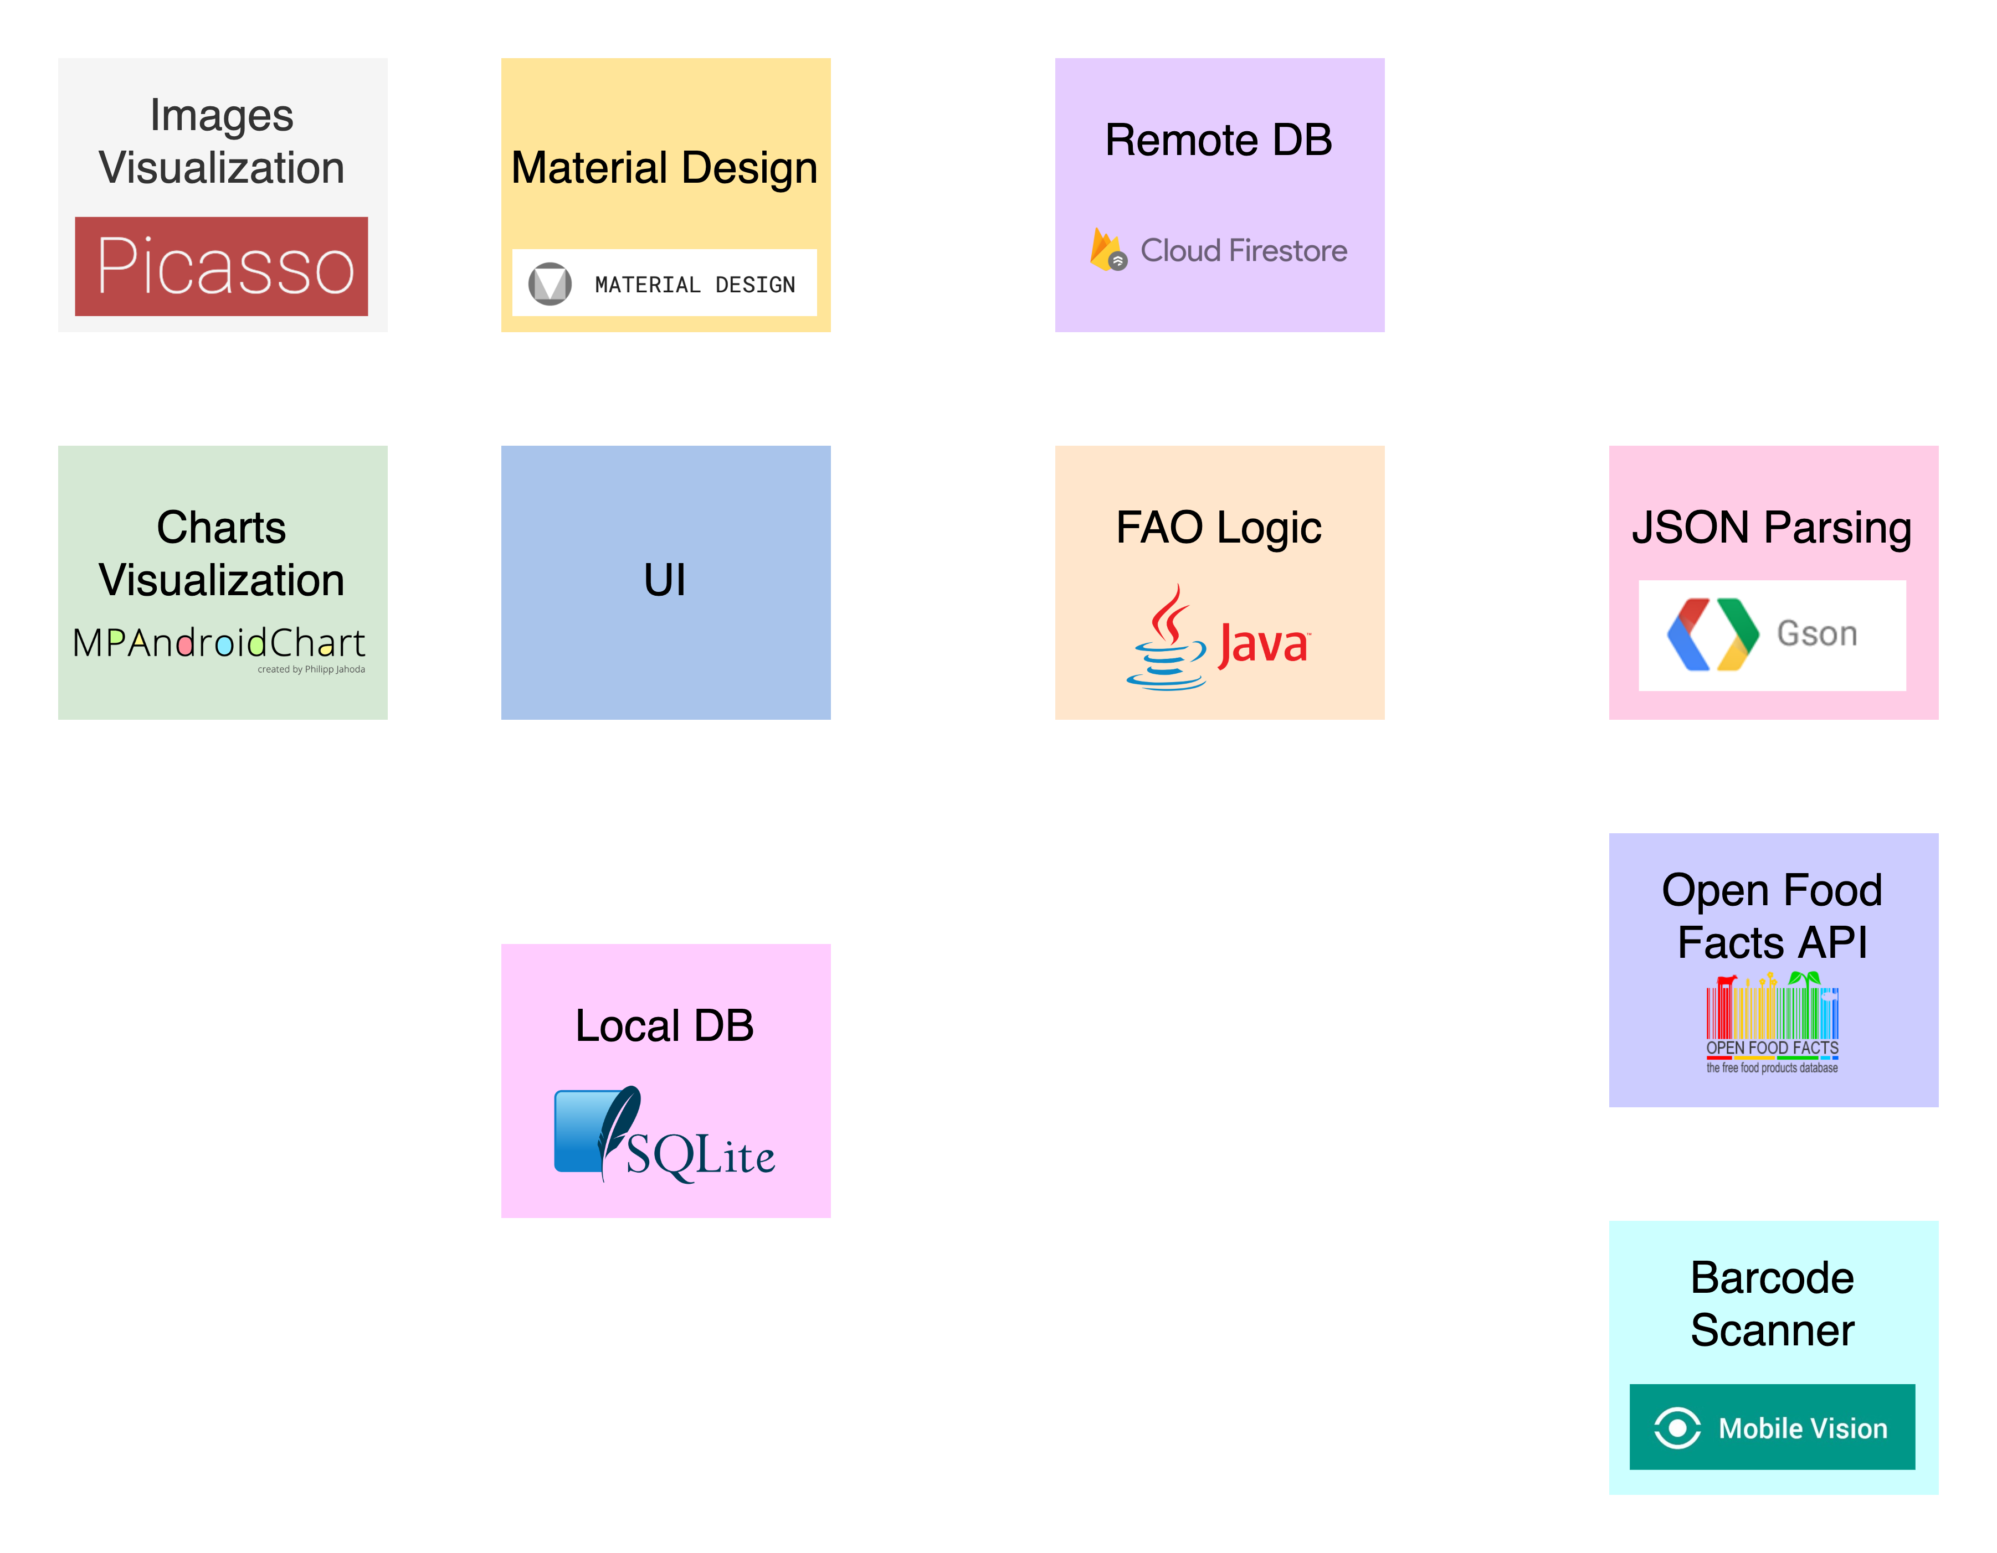
Architecture

Slide 5
Demo
Instructions: Show a short Demo (max 3 minutes) of your APP (either live or with a video)

Slide 6
Tasks of each group’s member
Name | Surname | Main Task | Subtasks | Status
Rocco | Felici | Barcodes scan Pantry management | Reading barcode | In progress
 |  |  | Parsing JSON | Done
 |  |  | Uploading data in DB | Done
Edoardo | Silva | Notifications Graphs Settings | Implementing chart view | Done
 |  |  | Conversion steps to calories | In progress
 |  |  | Sending notifications | In progress
Tommaso | Vitali | Handling databases Settings Step counter Recipes | Data from remote DB | Done
 |  |  | Data to shared preferences | In progress
 |  |  | Background step counter | Done

Slide 7
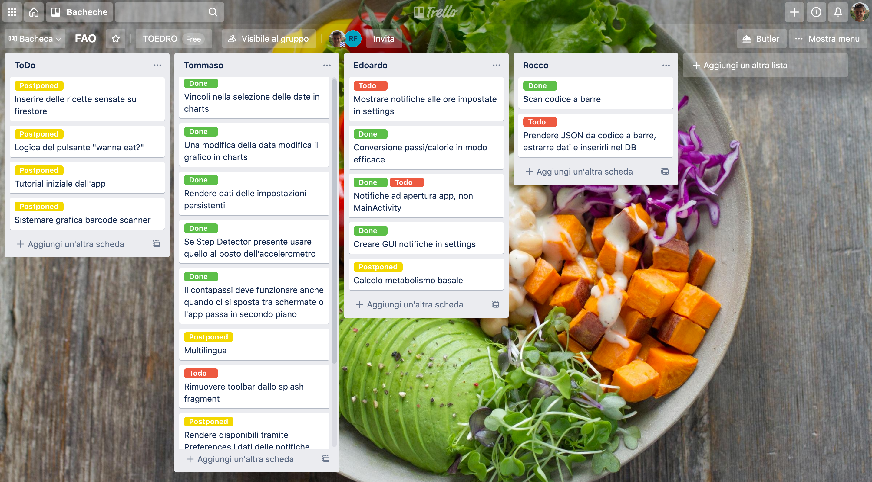
Tasks of each group’s member 2

Slide 8
Q&A

